Slide 1

Tree Methods
Let’s learn something!

Slide 2
Python and Spark
A very powerful group of algorithms falls under the “Tree Methods” title.
We’ll discuss decision trees, random forests, and gradient boosted trees!

Slide 3
Reading Assignment
Chapter 8 of
Introduction to Statistical Learning
By Gareth James, et al.

Slide 4
Tree Methods
Let’s start off with a thought experiment to give some motivation behind using a decision tree method.
Math &
Statistics
Machine Learning
DS
Software
Research
Domain
Knowledge

Slide 5
Tree Methods
Imagine that I play Tennis every Saturday and I always invite a friend to come with me.
Sometimes my friend shows up, sometimes not.
For him it depends on a variety of factors, such as: weather, temperature, humidity, wind etc..
I start keeping track of these features and whether or not he showed up to play with me.
Math &
Statistics
Machine Learning
DS
Software
Research
Domain
Knowledge

Slide 6
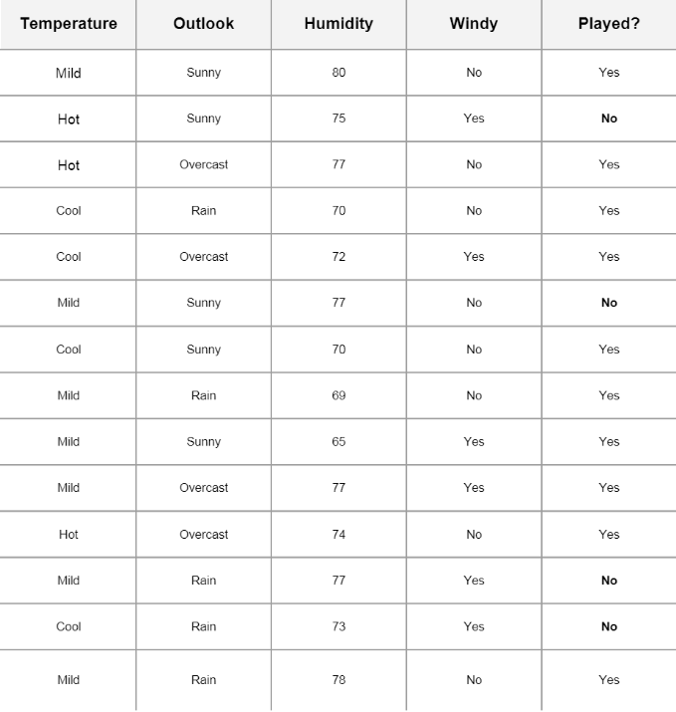
Tree Methods
Math &
Statistics
Machine Learning
DS
Software
Research
Domain
Knowledge

Slide 7
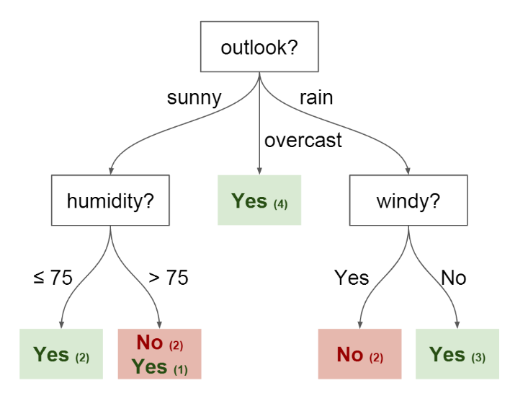
Tree Methods
I want to use this data to predict whether or not he will show up to play.
An intuitive way to do this is through a Decision Tree
Math &
Statistics
Machine Learning
DS
Software
Research
Domain
Knowledge

Slide 8
Tree Methods
In this tree we have:
Nodes
Split for the value of a certain attribute
Edges
Outcome of a split to next node
Math &
Statistics
Machine Learning
DS
Software
Research
Domain
Knowledge

Slide 9
Tree Methods
In this tree we have:
Root
The node that performs the first split
Leaves
Terminal nodes that predict the outcome
Math &
Statistics
Machine Learning
DS
Software
Research
Domain
Knowledge

Slide 10
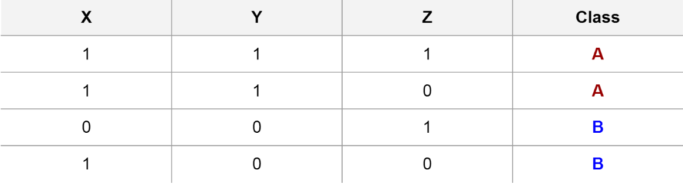
Intuition Behind Splits
Imaginary Data with 3 features (X,Y, and Z) with two possible classes.
Math &
Statistics
Machine Learning
DS
Software
Research
Domain
Knowledge

Slide 11
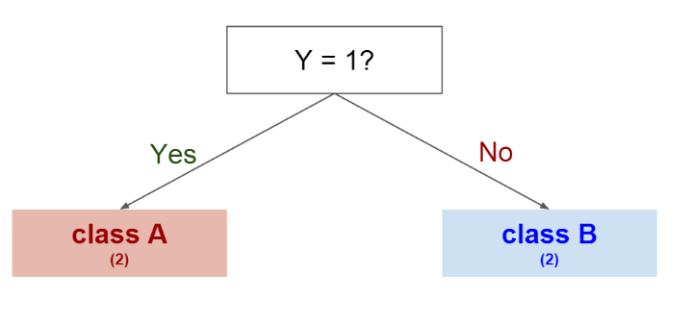
Intuition Behind Splits
Splitting on Y gives us a clear separation between classes
Math &
Statistics
Machine Learning
DS
Software
Research
Domain
Knowledge

Slide 12
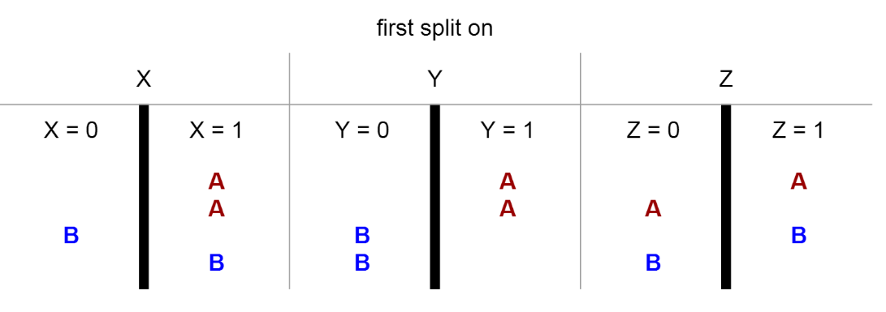
Intuition Behind Splits
We could have also tried splitting on other features first:
Math &
Statistics
Machine Learning

Slide 13
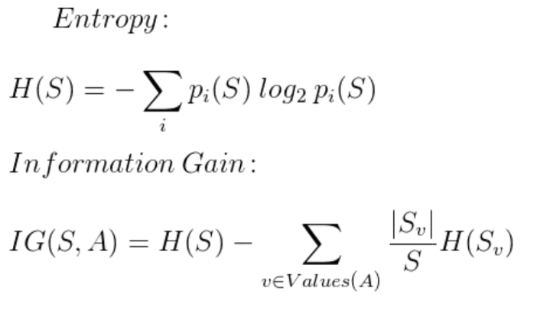
Intuition Behind Splits
Entropy and Information Gain are the Mathematical Methods of choosing the best split. Refer to reading assignment.
Math &
Statistics
Machine Learning

Slide 14
Random Forests
To improve performance, we can use many trees with a random sample of features chosen as the split.
A new random sample of features is chosen for every single tree at every single split.
Works for both classification and regression tasks!
Math &
Statistics
Machine Learning

Slide 15
Random Forests
What's the point?
Suppose there is one very strong feature in the data set. Most of the trees will use that feature as the top split, resulting in an ensemble of similar trees that are highly correlated.
Math &
Statistics
Machine Learning

Slide 16
Random Forests
What's the point?
Averaging highly correlated quantities does not significantly reduce variance.
By randomly leaving out candidate features from each split, Random Forests "decorrelates" the trees, such that the averaging process can reduce the variance of the resulting model.
Math &
Statistics
Machine Learning

Slide 17
Python and Spark
Finally, let’s discuss Gradient Boosted Trees!

Slide 18
Python and Spark
Gradient boosting involves three elements:
A loss function to be optimized.
A weak learner to make predictions.
An additive model to add weak learners to minimize the loss function.

Slide 19
Python and Spark
Loss Function
A loss function in basic terms is the function/equation you will use to determine how “far off” your predictions are.

Slide 20
Python and Spark
Loss Function
For example, regression may use a squared error and classification may use logarithmic loss.
We won’t have to deal with this directly using Spark.

Slide 21
Python and Spark
Weak Learner
Decision trees are used as the weak learner in gradient boosting.
It is common to constrain the weak learners: such as a maximum number of layers, nodes, splits or leaf nodes.

Slide 22
Python and Spark
Additive Model
Trees are added one at a time, and existing trees in the model are not changed.
A gradient descent procedure is used to minimize the loss when adding trees.

Slide 23
Python and Spark
So what is the most intuitive way to think about all this if Spark does this all for us?
Here is a nice way to think about it in 3 “easy” steps

Slide 24
Python and Spark
Train a weak model m using data samples drawn according to some weight distribution

Slide 25
Python and Spark
2. Increase the weight of samples that are misclassified by model m, and decrease the weight of samples that are classified correctly by model m

Slide 26
Python and Spark
3. Train next weak model using samples drawn according to the updated weight distribution.

Slide 27
Python and Spark
In this way, the algorithm always trains models using data samples that are "difficult" to learn in previous rounds, which results an ensemble of models that are good at learning different "parts" of training data.

Slide 28
Python and Spark
Basically “boosting” weights of samples that were difficult to get correct.

Slide 29
Python and Spark
The real details of gradient boosting lies in the mathematics, which you may or may not be ready for depending on your background.
The full details are at the end of Chapter 8 of ISLR!

Slide 30
Python and Spark
Spark handles all of this “under the hood” for you, so you can use the defaults if you want, or dive into ISLR and begin to play around with the parameters!
Let’s continue!

Slide 31
Tree Methods
Documentation Example
Let’s learn something!

Slide 32
Python and Spark
Now that we have some intuitive understanding of how these algorithms work, let’s dive into the documentation examples!

Slide 33
Python and Spark
We’ll work through Decision Tree, Random Forest and Gradient Boosted Trees.
We will also expand a little more from the documentation example and show some useful evaluation features!

Slide 34
Tree Methods
Code Along

Slide 35
Python and Spark
We’ll work through all 3 Tree Methods discussed and compare their results on a college dataset.
The data set has features of universities and labeled either Private or Public.
Let’s get started!

Slide 36
Tree Methods
Consulting Project
Let’s learn something!

Slide 37

Python and Spark
You’ve been contracted by the Purina Dog Food company and flown out to their HQ in St. Louis, Missouri!

Slide 38
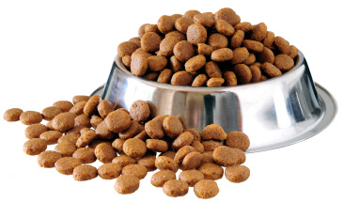
Python and Spark
You've been hired by a dog food company to try to predict why some batches of their dog food are spoiling much quicker than intended!

Slide 39
Python and Spark
Unfortunately this Dog Food company hasn't upgraded to the latest machinery, meaning that the amounts of the five preservative chemicals they are using can vary a lot, but which is the chemical that has the strongest effect?

Slide 40
Python and Spark
The dog food company first mixes up a batch of preservative that contains 4 different preservative chemicals (A,B,C,D) and then is completed with a "filler" chemical.

Slide 41
Python and Spark
The food scientists believe one of the A,B,C, or D preservatives is causing the problem, but need your help to figure out which one!

Slide 42
Python and Spark
Use Machine Learning with RF to find out which parameter had the most predictive power, thus finding out which chemical causes the early spoiling!
So create a model and then find out how you can decide which chemical is the problem!

Slide 43
Python and Spark
Their data looks like this:
Pres_A : Percentage of preservative A in the mix
Pres_B : Percentage of preservative B in the mix
Pres_C : Percentage of preservative C in the mix
Pres_D : Percentage of preservative D in the mix
Spoiled: Label indicating whether or not the dog food batch was spoiled.

Slide 44
Python and Spark
Think carefully about what this problem is really asking you to solve.
While we will use Machine Learning to solve this, it won't be with your typical train/test split workflow. If this confuses you, skip ahead to the solution code along!

Slide 45
Tree Methods
Consulting Project
Solutions

Slide 46
Python and Spark
Our main task was to figure out which preservative chemical (A,B,C,D) was having an effect on the dog food being spoiled.
So how can we use machine learning models to solve this?

Slide 47
Python and Spark
Many machine learning models produce some sort of coefficient value for each feature involved, indicating their “importance” or predictive power.
Remember back to the documentation lecture for this section of the course!

Slide 48
Python and Spark
We mentioned that these tree method classifiers had a .featureImportances attribute available!
So we can create a model, fit it on all the data, and then check which feature (preservative) was causing the spoilage!

Slide 49
Python and Spark
.featureImportances returns:
SparseVector(4, {0: 0.0026, 1: 0.0089, 2: 0.9686, 3: 0.0199})
Corresponding to a features column:
Row(features=DenseVector([4.0, 2.0, 12.0, 3.0]), Spoiled=1.0)

Slide 50
Python and Spark
There are many different ways to solve this problem, including just using “pure” statistics instead of a machine learning model.

Slide 51
Python and Spark
Hopefully this consulting project shows how we can apply machine learning in a different way from previous examples.
In this case we don’t really care about test/train splits or deployments.

Slide 52
Python and Spark
What we really want to understand is the fundamental relationship between each feature column and the label itself.

